Slide 1
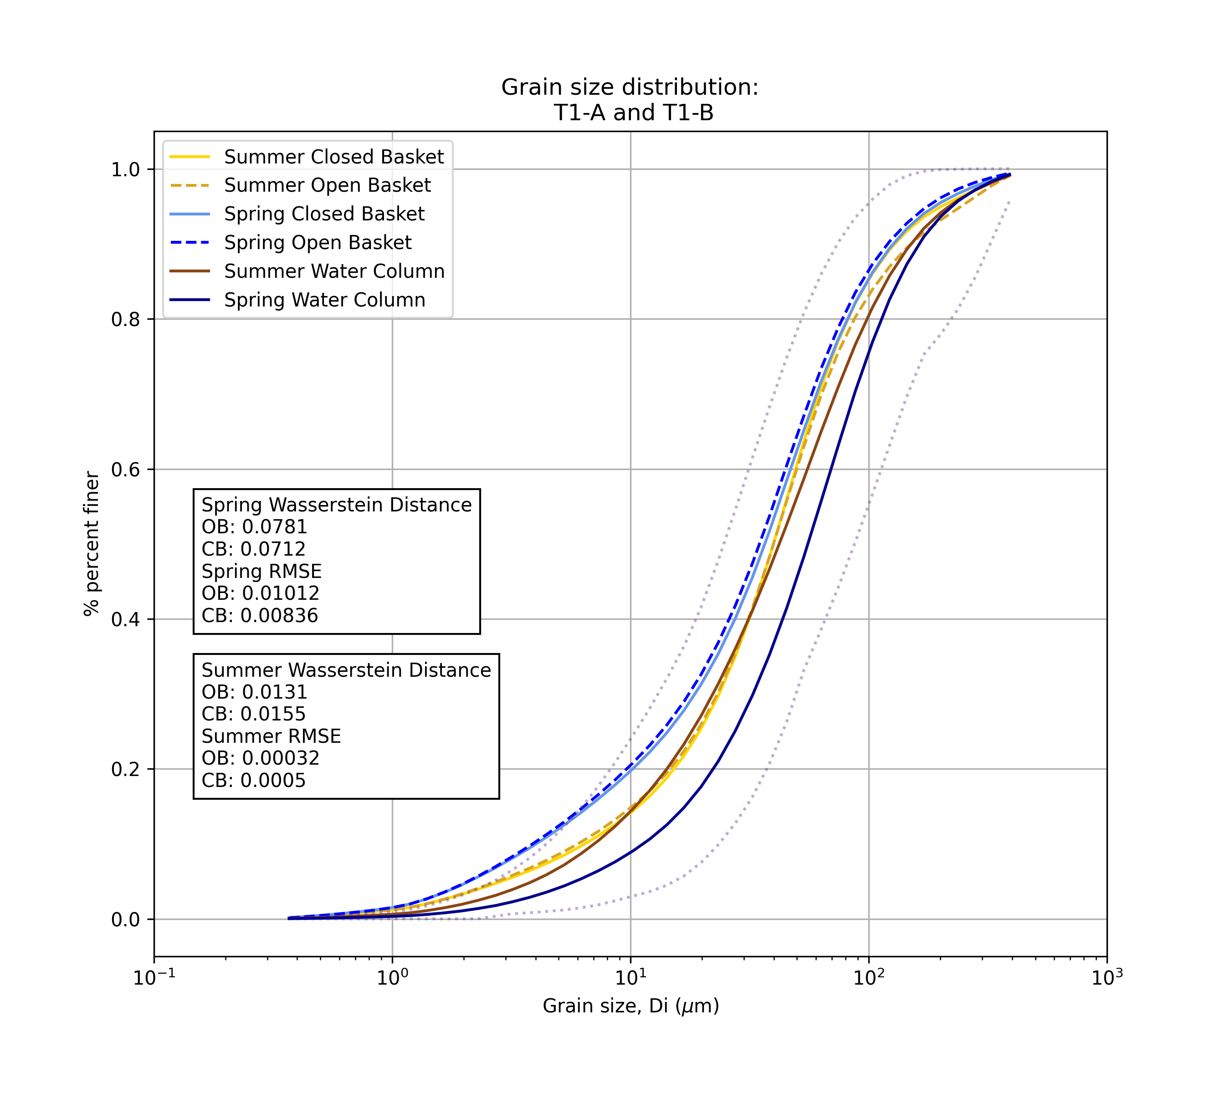
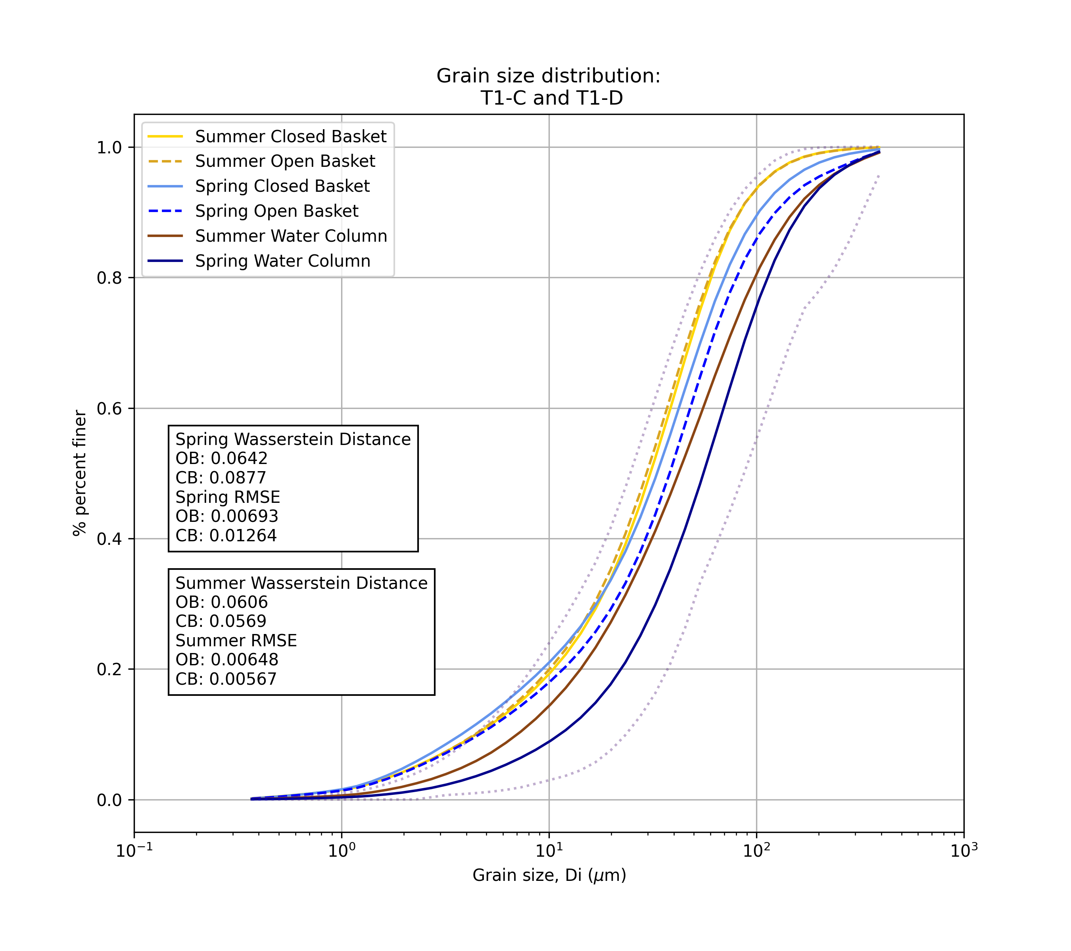
In spring the difference between trap and water column GSD are larger than in the summer
T1 in spring was upwelling and was downwelling in summer

Slide 2
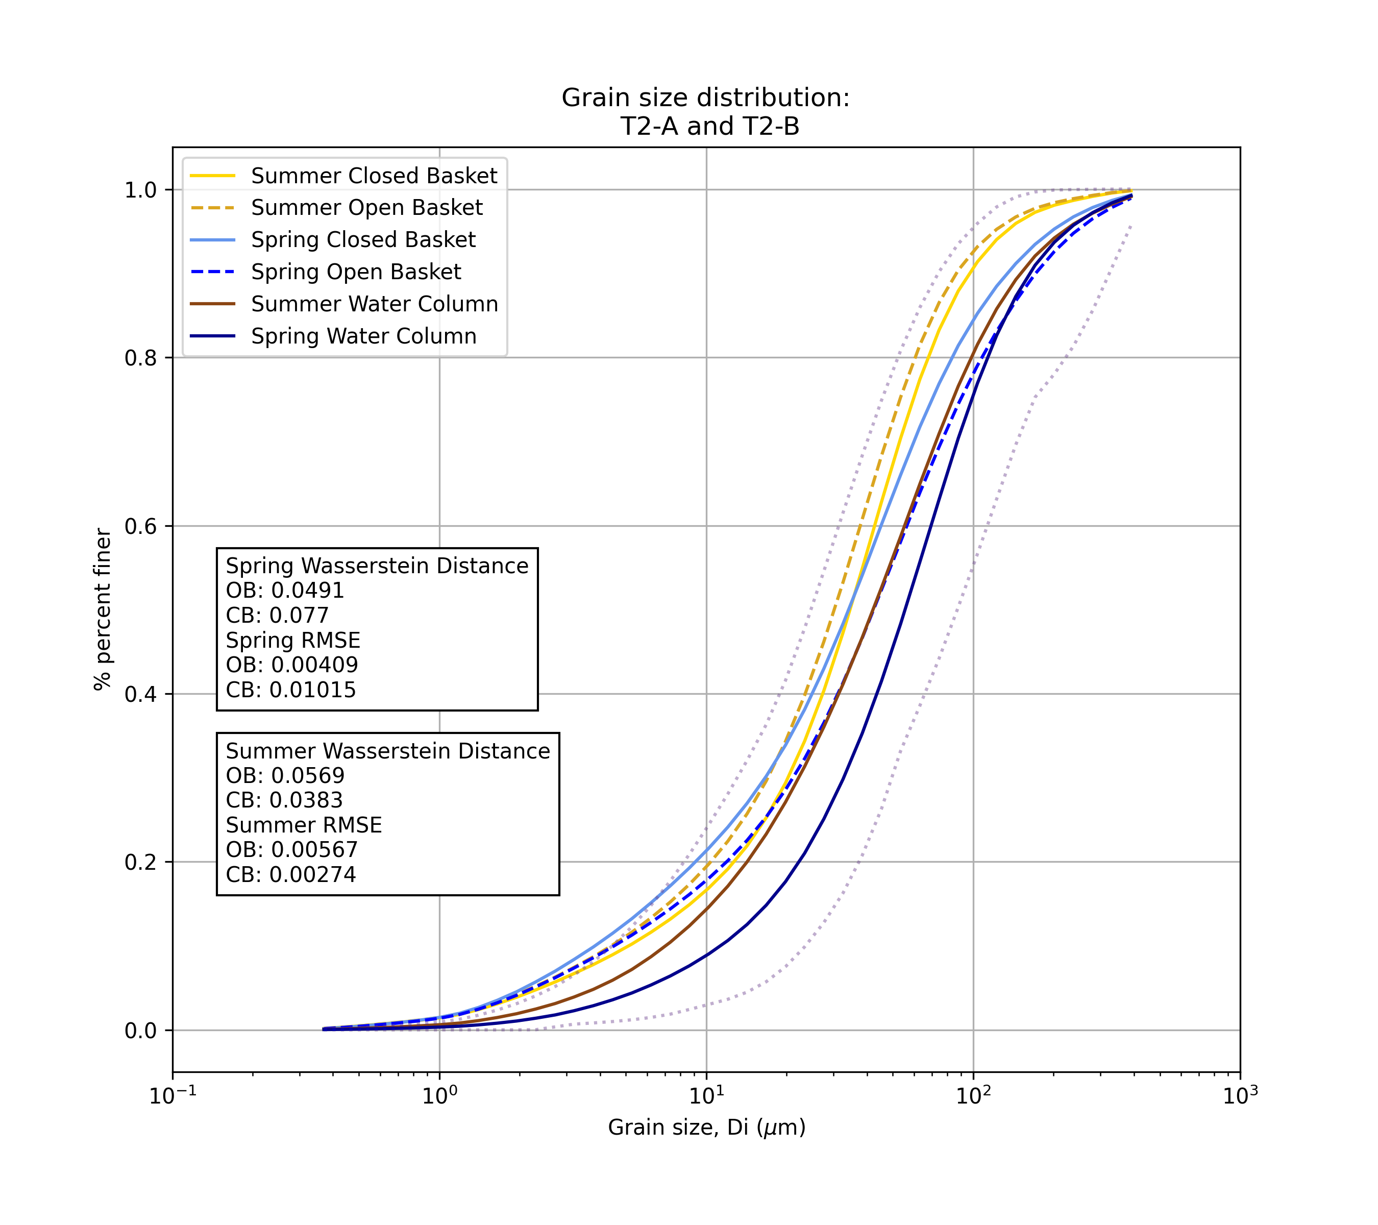
T2 is downwelling for both seasons (it’s the one with largest downstream magnitude)
Open baskets in both seasons have more similar distributions to the water column

Slide 3
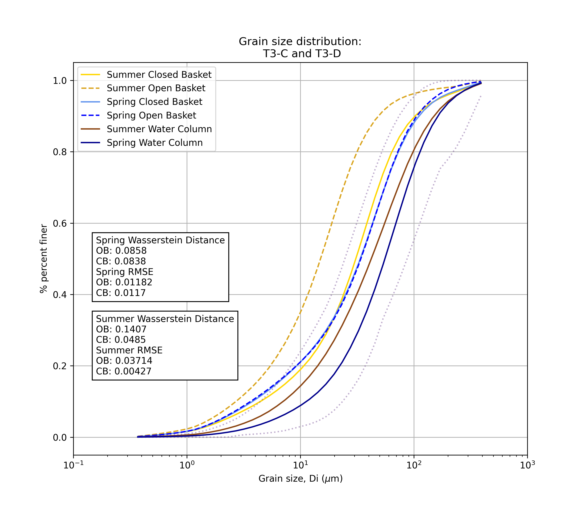
T3 is downwelling for both seasons
Closed baskets in both seasons have more similar distributions to the water column

Slide 4
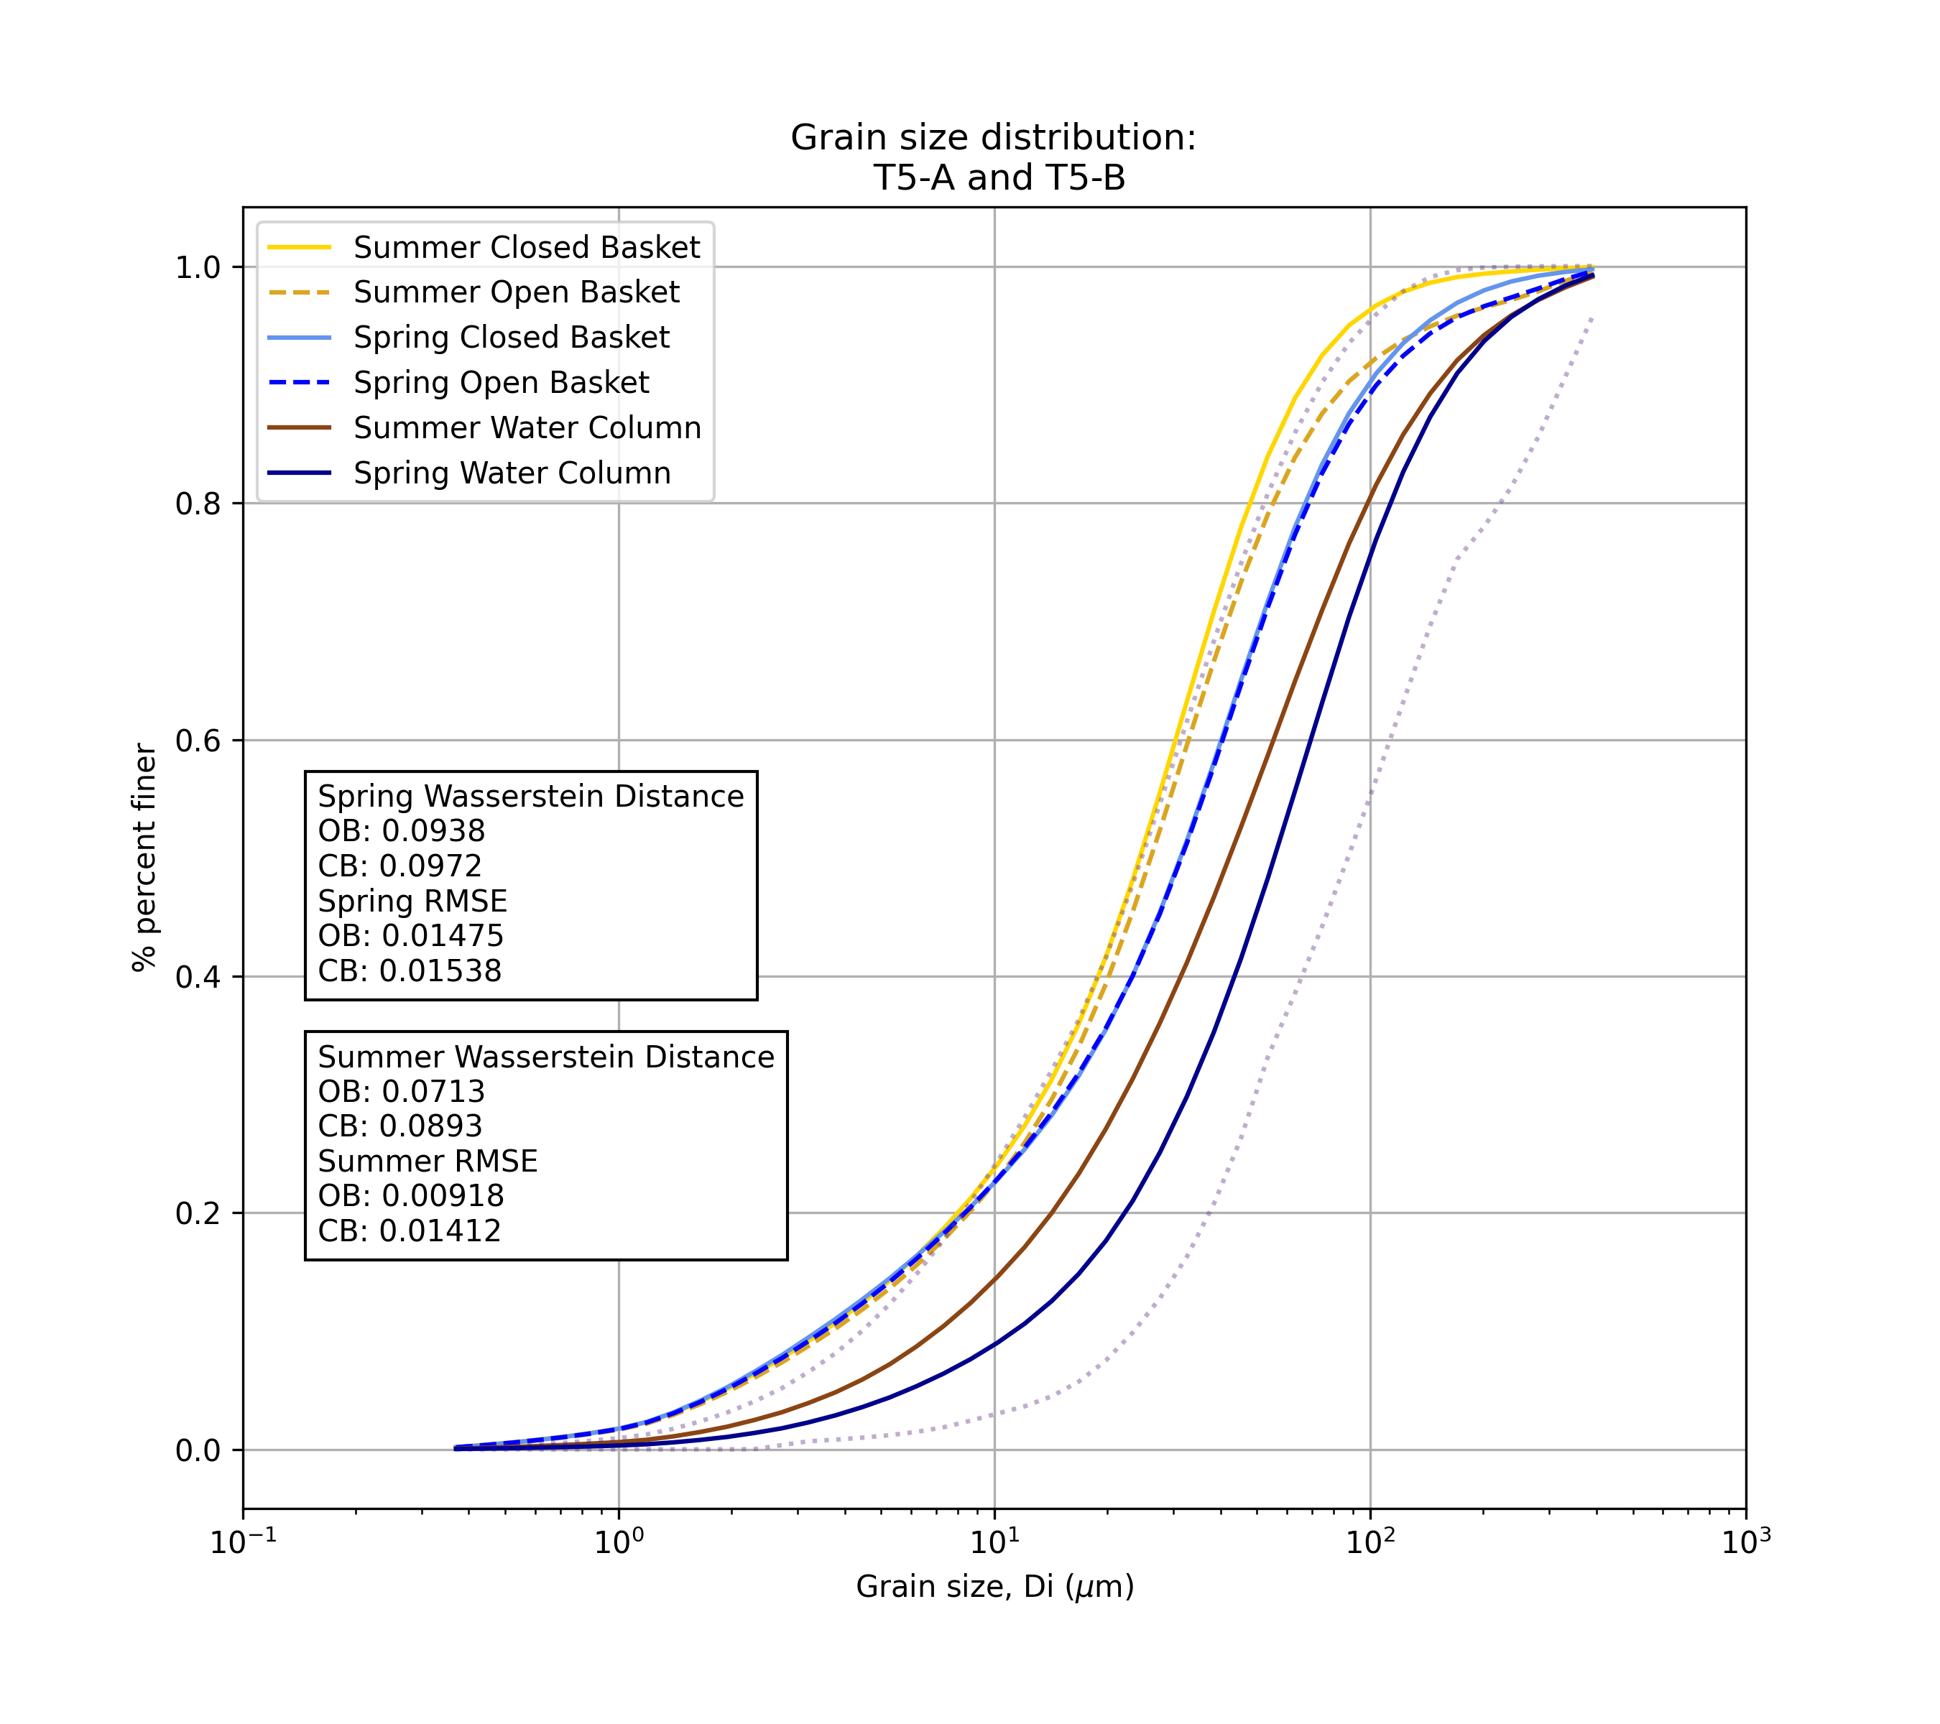
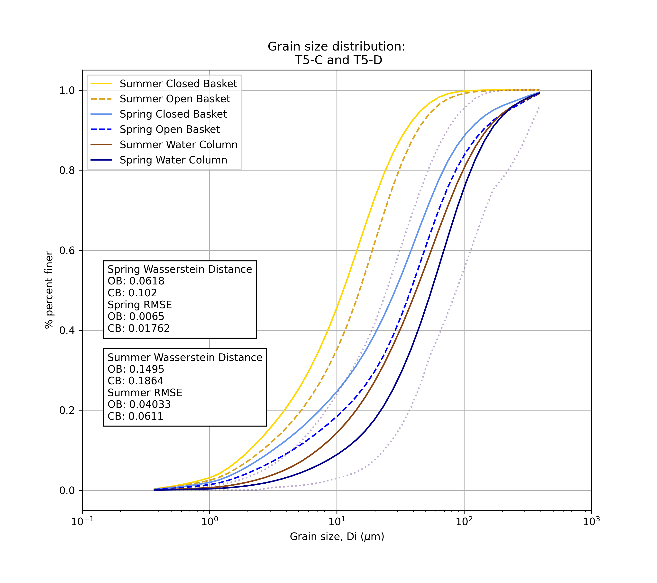
T5 is upwelling for both seasons
Open baskets in both seasons have more similar distributions to the water column
Summer has more similar GSDs between traps and water column
T5 is upwelling for both seasons
Open baskets in both seasons have more similar distributions to the water column

Slide 5
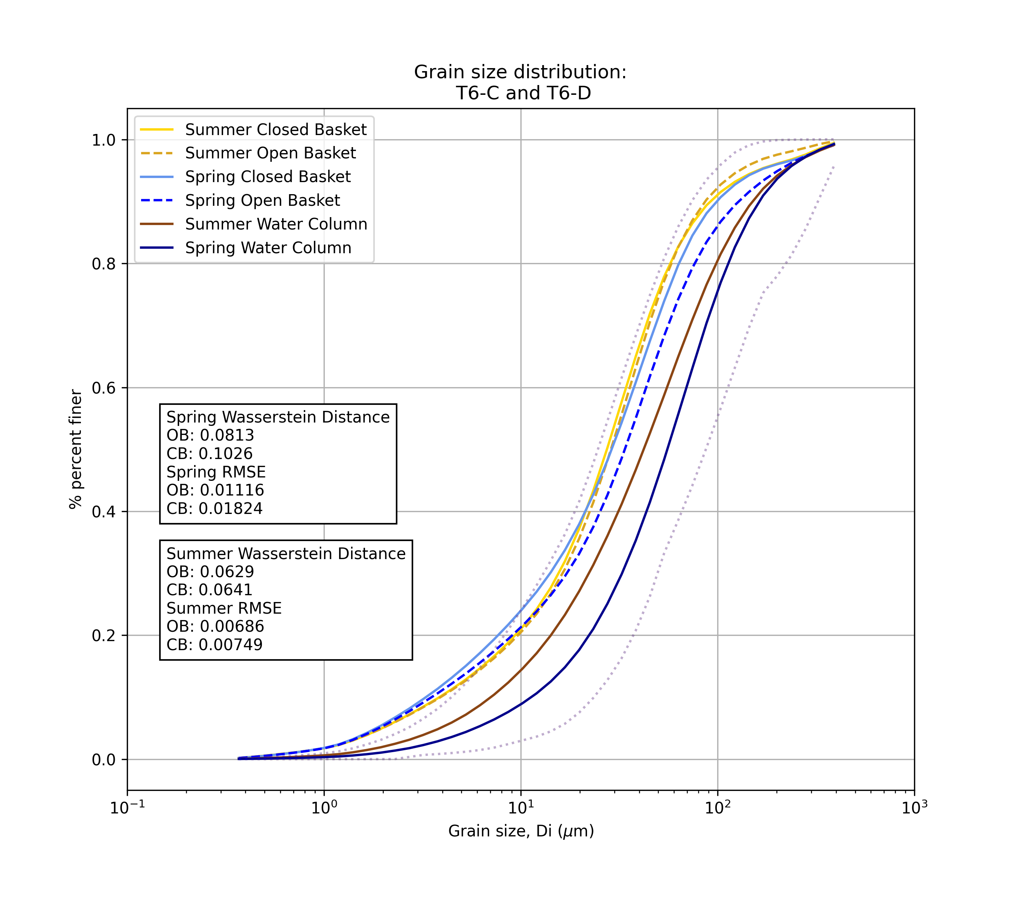
T6 is downwelling for both seasons
Open baskets in both seasons have more similar distributions to the water column
Summer has more similar GSDs between traps and water column

Slide 6
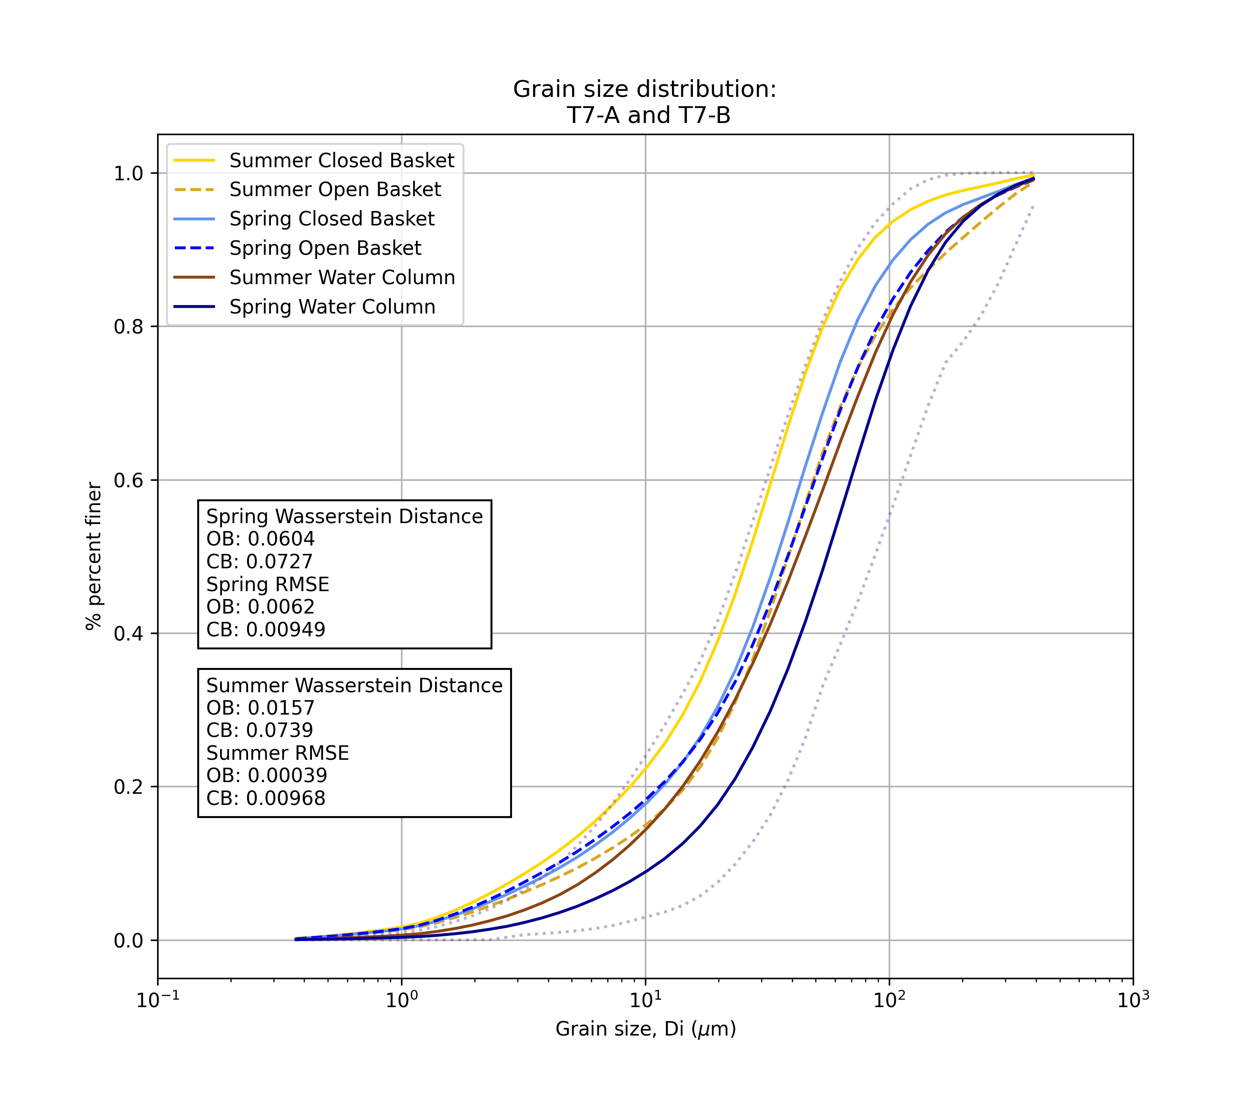
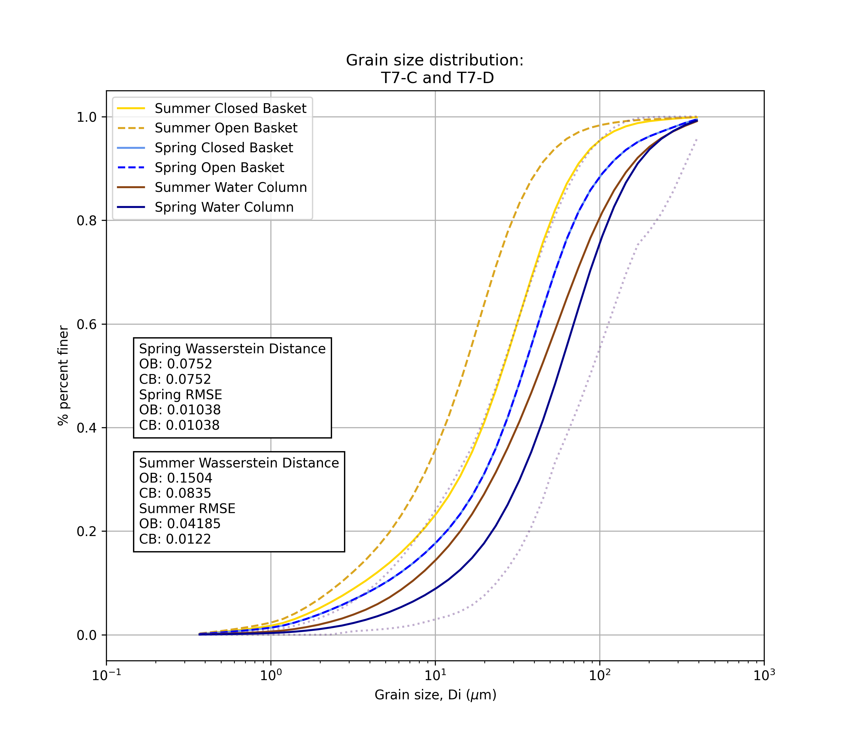
T7 is downwelling for both seasons
Open baskets in both seasons have more similar distributions to the water column
Summer has more similar GSDs between traps and water column
T7 is downwelling for both seasons
Closed baskets in both seasons have more similar distributions to the water column
Summer has more similar GSDs between traps and water column

Slide 7
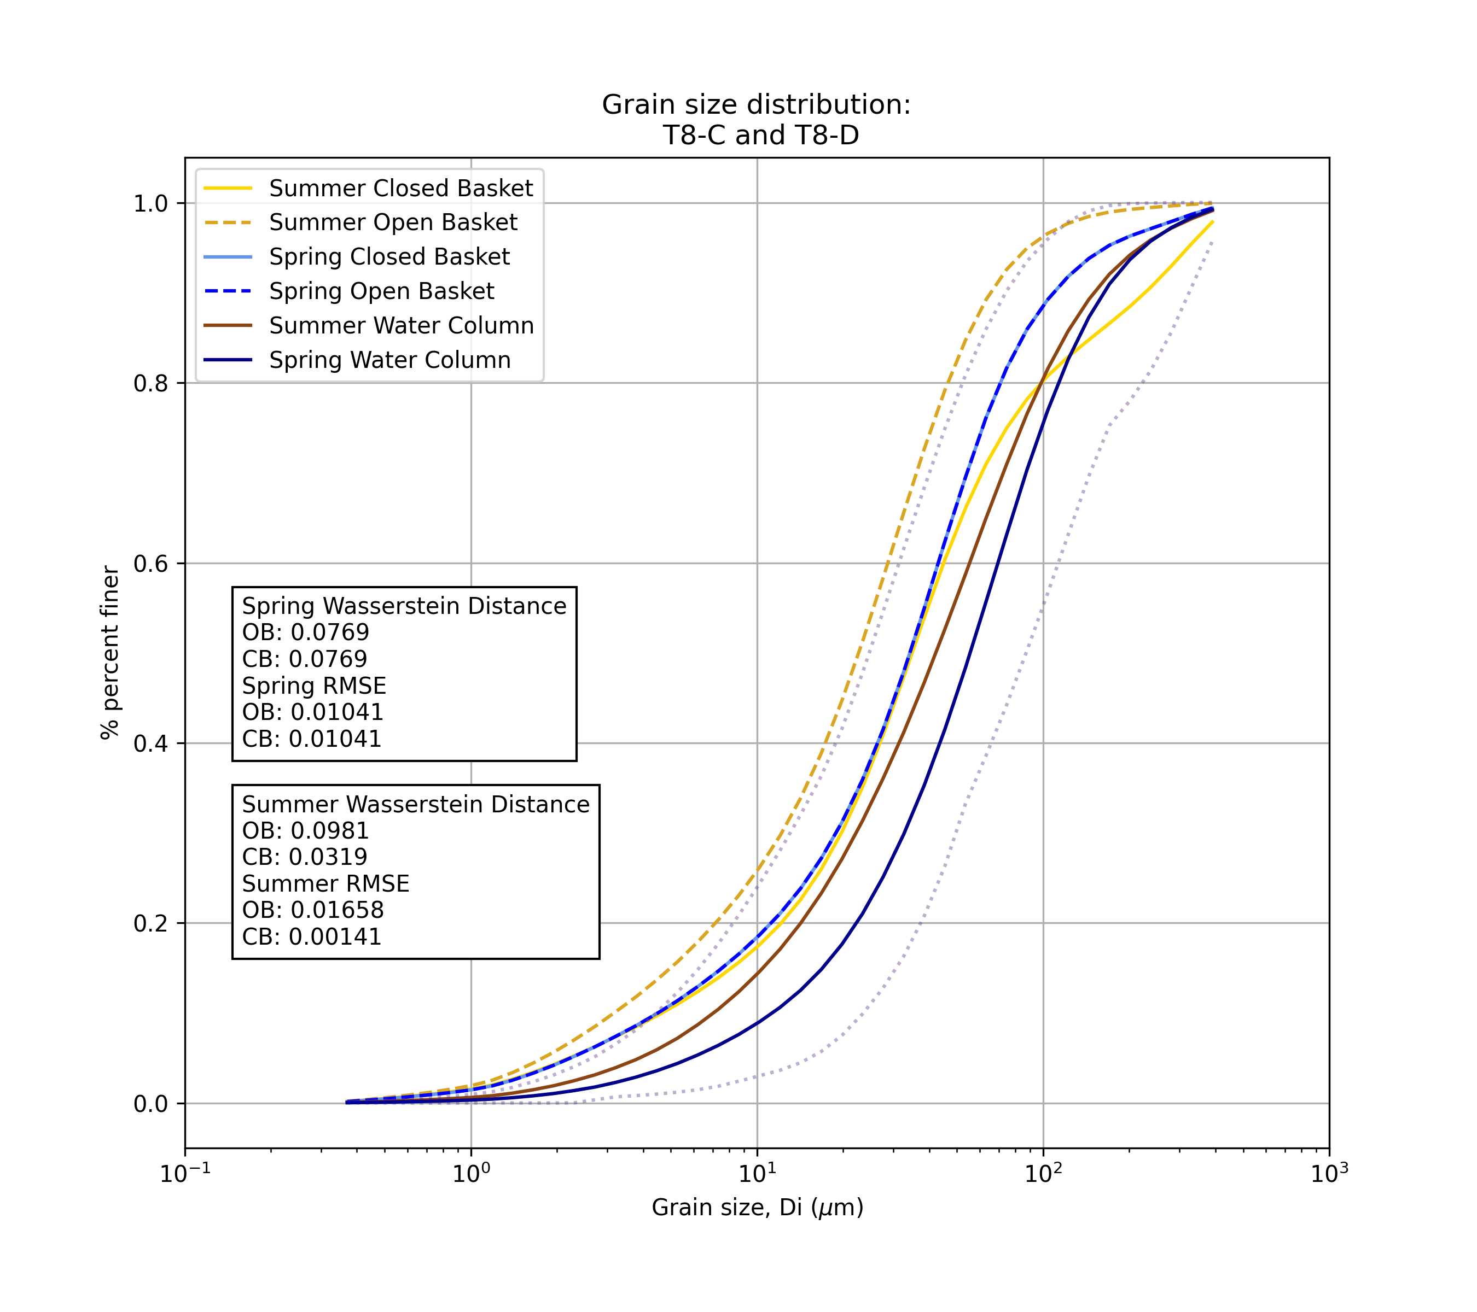
T8 is downwelling for both seasons (neutral)
Closed baskets in both seasons have more similar distributions to the water column
No consistent seasonal difference

Slide 8
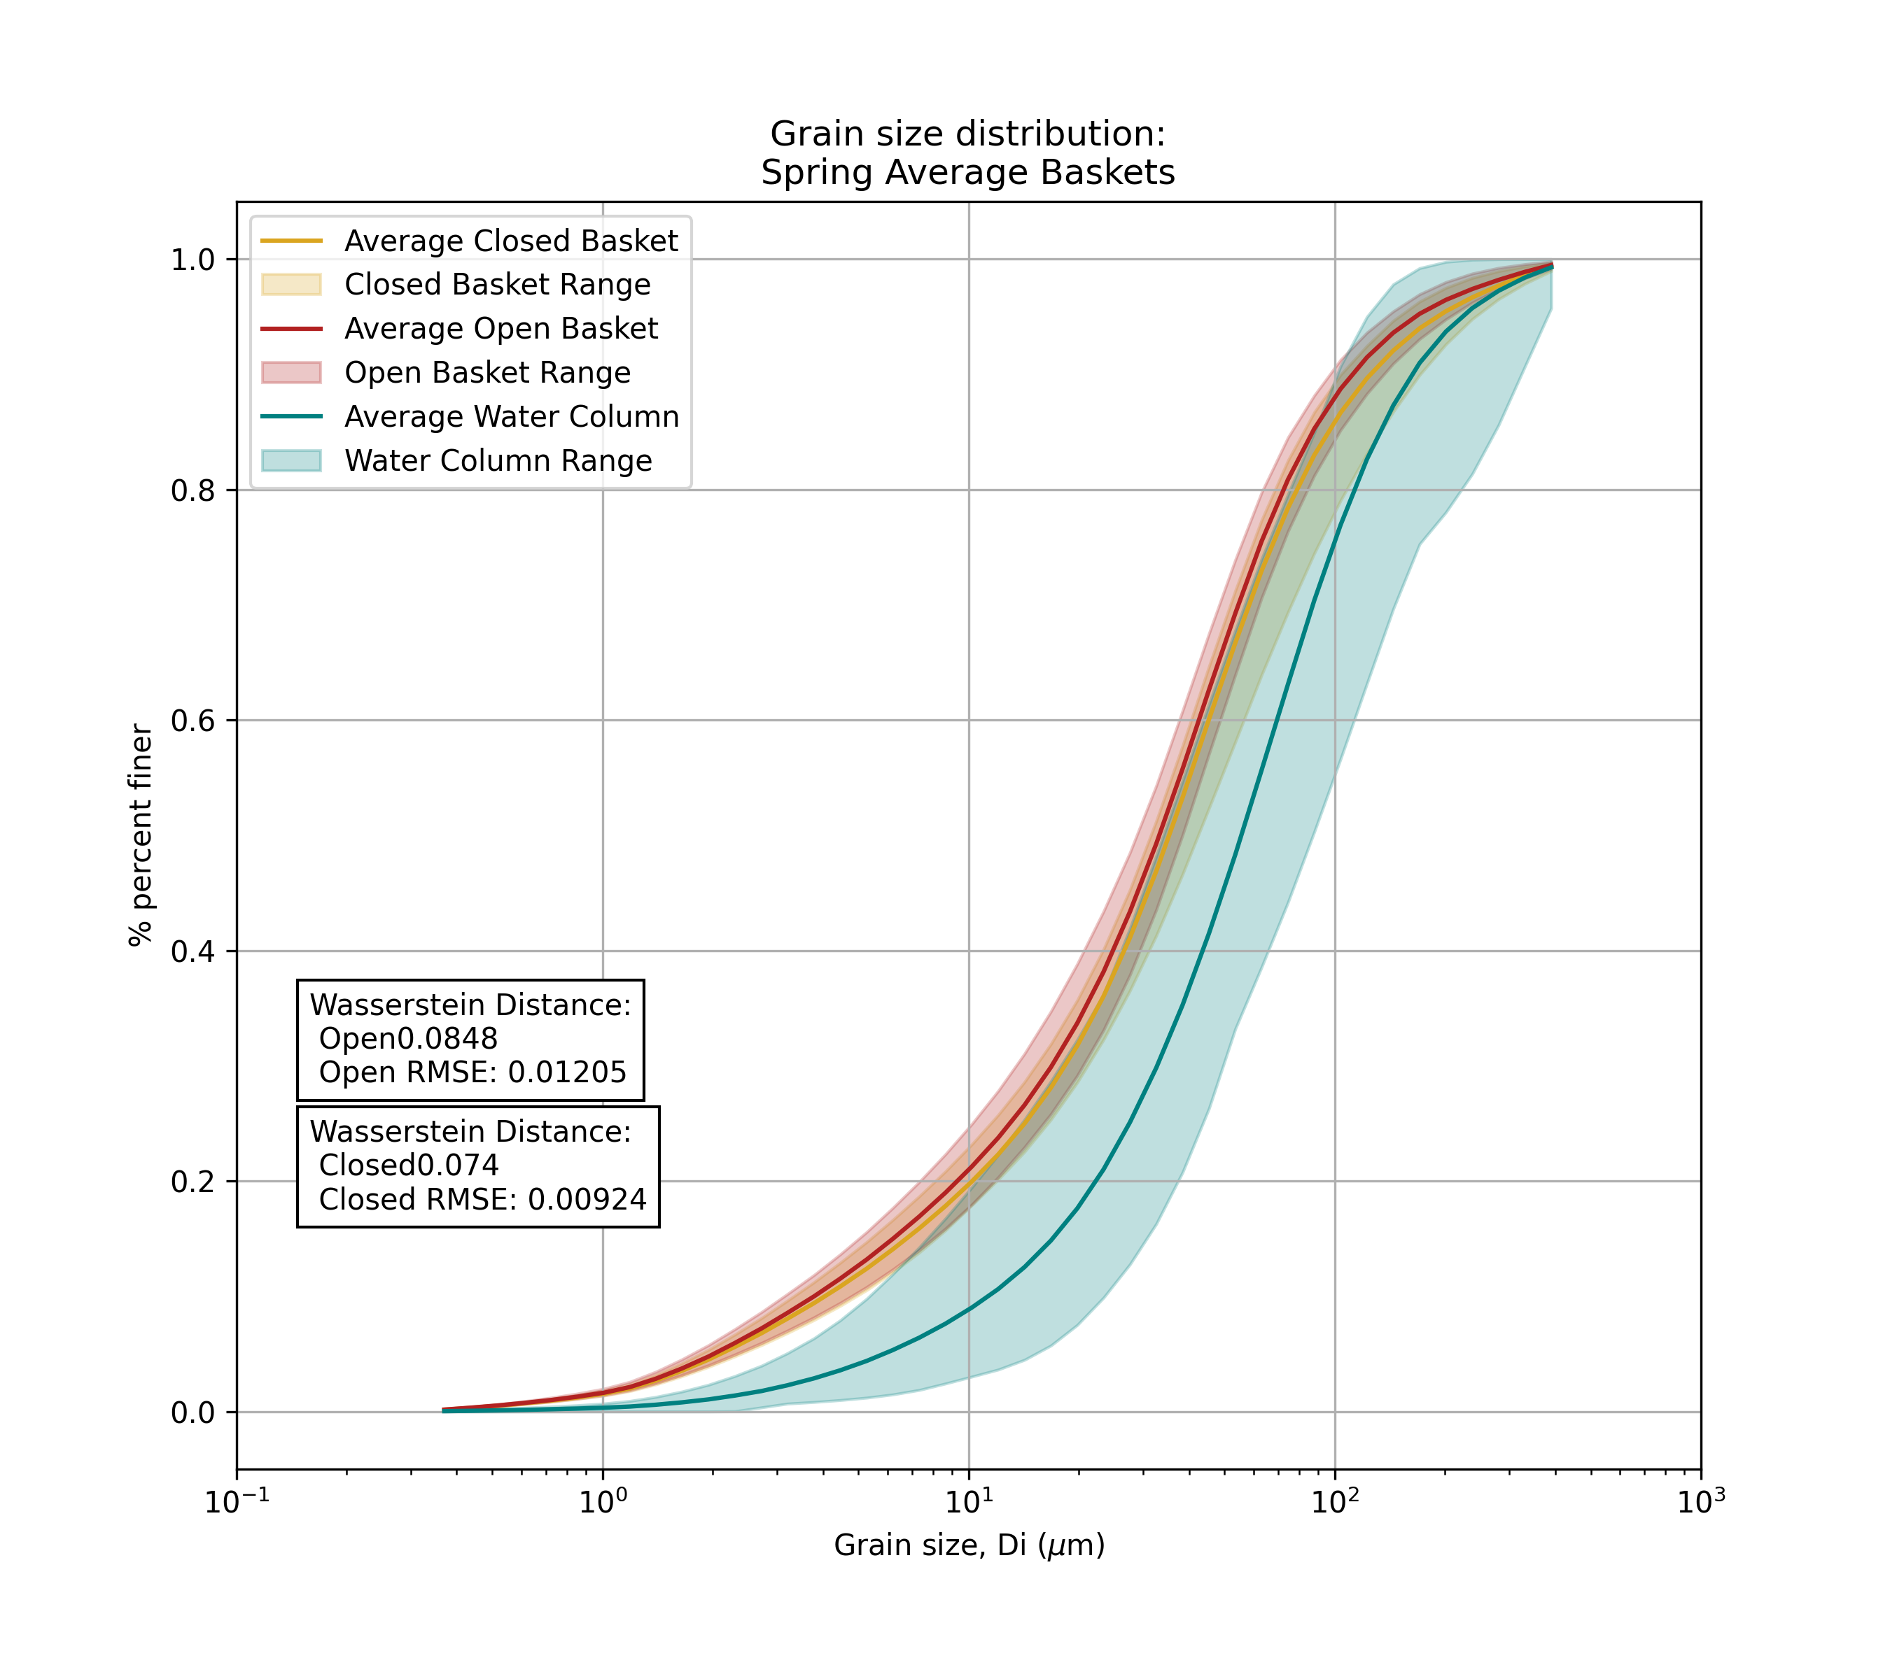
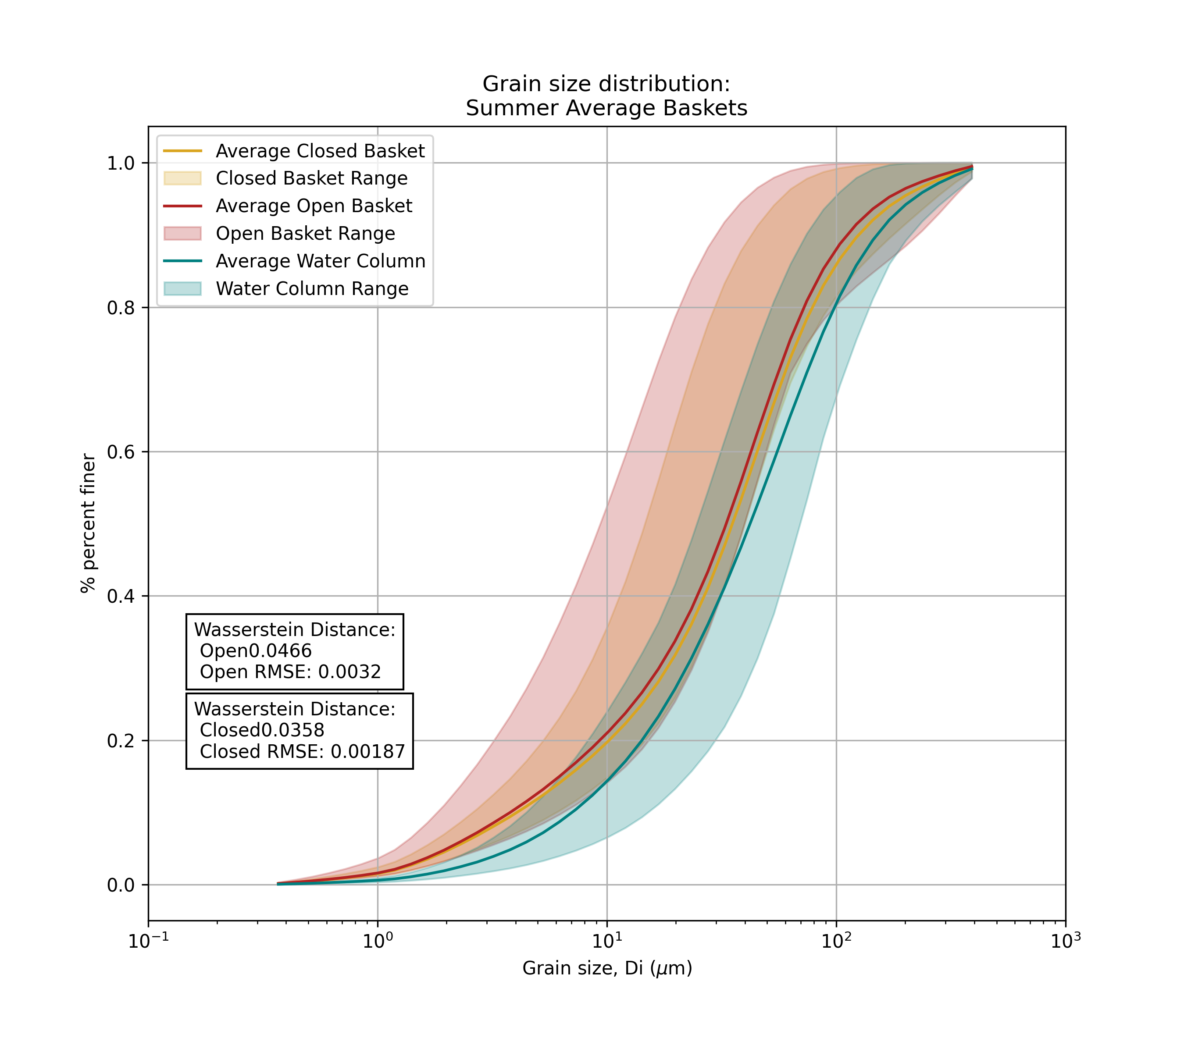
Average closed basket GSDs are more like water column GSDs than open baskets in spring
Average closed basket GSDs are more like water column GSDs than open baskets in summer
No seasonal difference, except that the variability in GSDs in summer is much grater. Also, these plots do not account for hyporheic flux direction

Slide 9

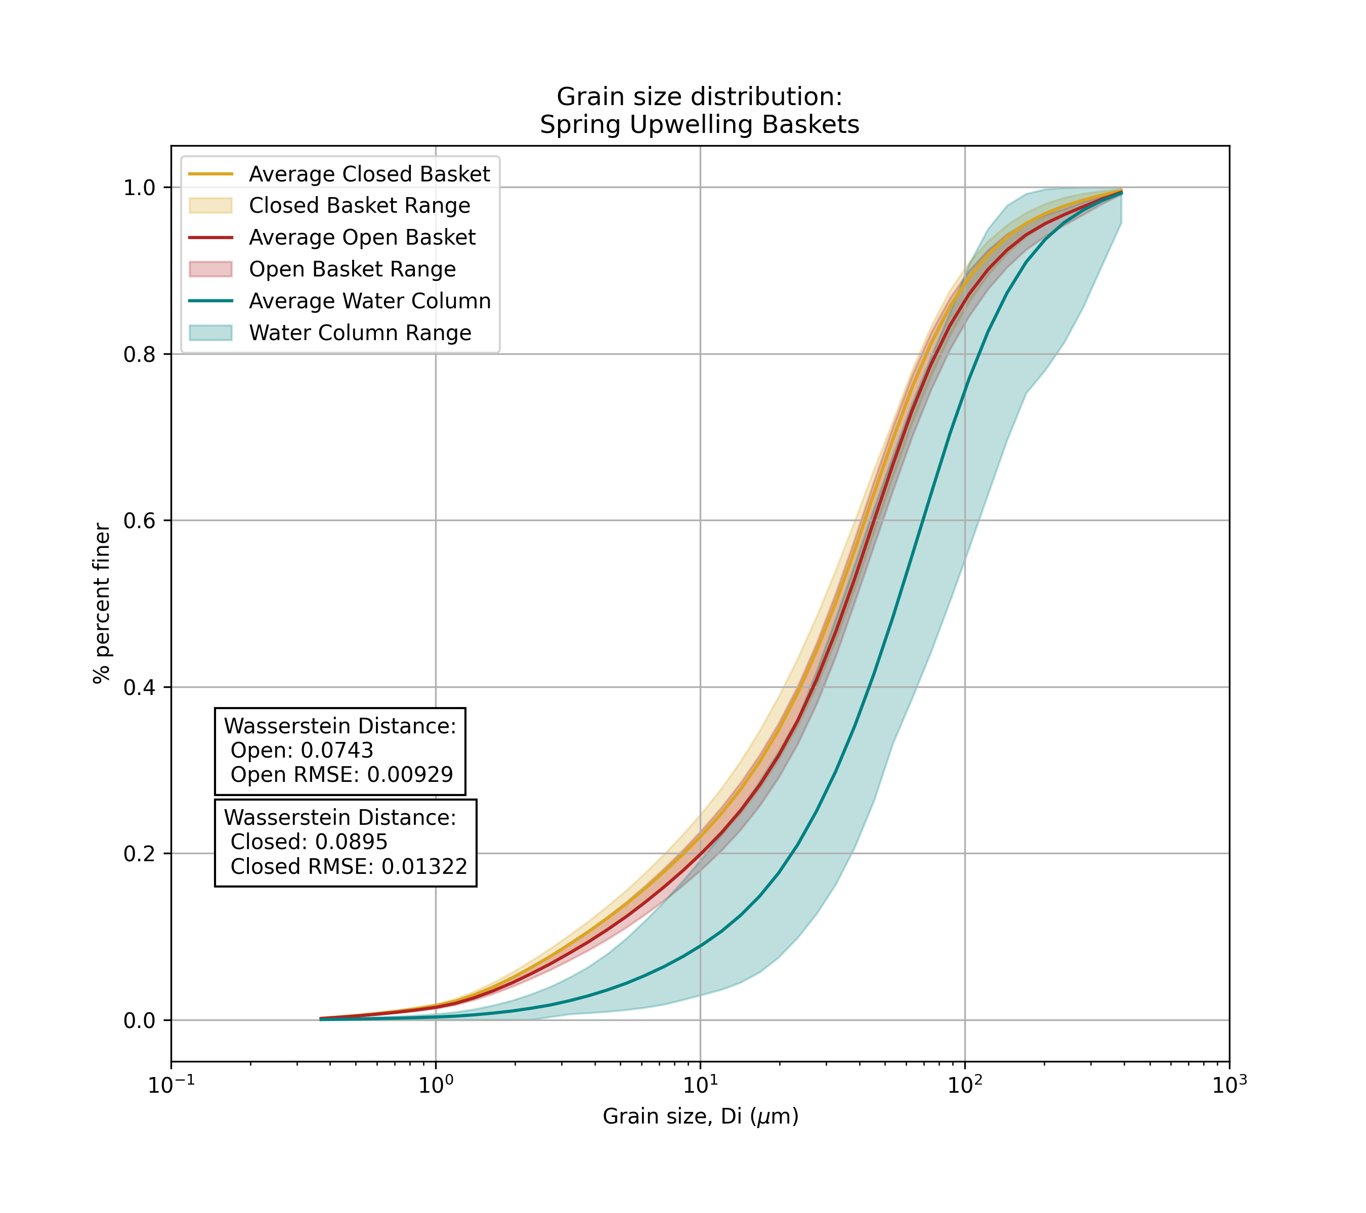

Slide 10
